Slide 1


Artificial Neural networks
Identification of objects from images
TARIQ S – PES1201700961
SAHIL F – PES1201701653
BHUVAN M R – PES1201701823

Slide 2
Problem Statement
Classification of objects from the given images using Convolutional Neural Network

Slide 3
Basic Network Model
Pre-processing of Dataset
Convolutional Neural Network
Output:
Category of the image

Slide 4
Dataset
Dataset consists of 5 categories namely: Cap, Rubiks Cube, Playing cards, Screwdriver, Torch.
Each category contains around 20 images.
Dataset has been divided into two sets, one for training and one for validating the data.

Slide 5
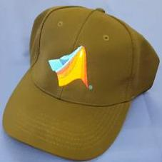
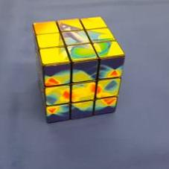
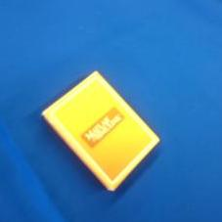
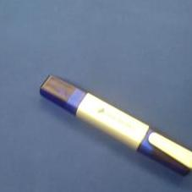
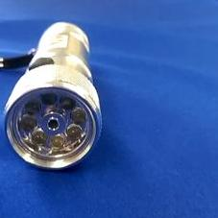
Dataset Samples

Slide 6
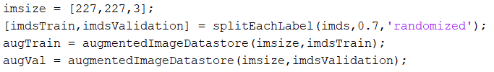
Pre-processing of Dataset
All the images must be of same resolution.
Using augmentedImageDatastore( ) function, all the images of the dataset are resized to (227,227,3).
70% of the dataset is used for training and the rest for validation.

Slide 7
About The Network
Image Input Layer
An imageInputLayer is where you specify the image size, which, in this case, is 227 X 227 X 3 These numbers correspond to the height, width, and the channel size.
Convolutional Layer
In the convolutional layer, the first argument is filterSize, which is the height and width of the filters the training function uses while scanning along the images. In this example, the number 3 indicates that the filter size is 3-by-3. You can specify different sizes for the height and width of the filter. The second argument is the number of filters, numFilters, which is the number of neurons that connect to the same region of the input.

Slide 8
Batch Normalization Layer:
Batch normalization layers normalize the activations and gradients propagating through a network, making network training an easier optimization problem. Use batch normalization layers between convolutional layers and nonlinearities, such as ReLU layers, to speed up network training and reduce the sensitivity to network initialization. Use batchNormalizationLayer to create a batch normalization layer.
Relu Layer:
The batch normalization layer is followed by a nonlinear activation function. The most common activation function is the rectified linear unit (ReLU). Use reluLayer to create a ReLU layer.

Slide 9
Max Pooling Layer:
Convolutional layers (with activation functions) are sometimes followed by a down-sampling operation that reduces the spatial size of the feature map and removes redundant spatial information. Down-sampling makes it possible to increase the number of filters in deeper convolutional layers without increasing the required amount of computation per layer. One way of down-sampling is using a max pooling, which you create using maxPooling2dLayer.
Fully Connected Layer:
The convolutional and down-sampling layers are followed by one or more fully connected layers. As its name suggests, a fully connected layer is a layer in which the neurons connect to all the neurons in the preceding layer. This layer combines all the features learned by the previous layers across the image to identify the larger patterns. The last fully connected layer combines the features to classify the images. Therefore, the OutputSize parameter in the last fully connected layer is equal to the number of classes in the target data.

Slide 10
Softmax Layer:
The softmax activation function normalizes the output of the fully connected layer. The output of the softmax layer consists of positive numbers that sum to one, which can then be used as classification probabilities by the classification layer. Create a softmax layer using the softmaxLayer function after the last fully connected layer.
Classification Layer:
The final layer is the classification layer. This layer uses the probabilities returned by the softmax activation function for each input to assign the input to one of the mutually exclusive classes and compute the loss. To create a classification layer, use classificationLayer.

Slide 11
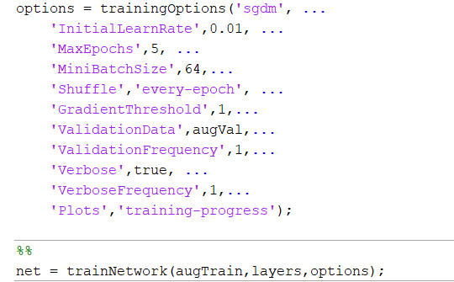
Training the Network

Slide 12
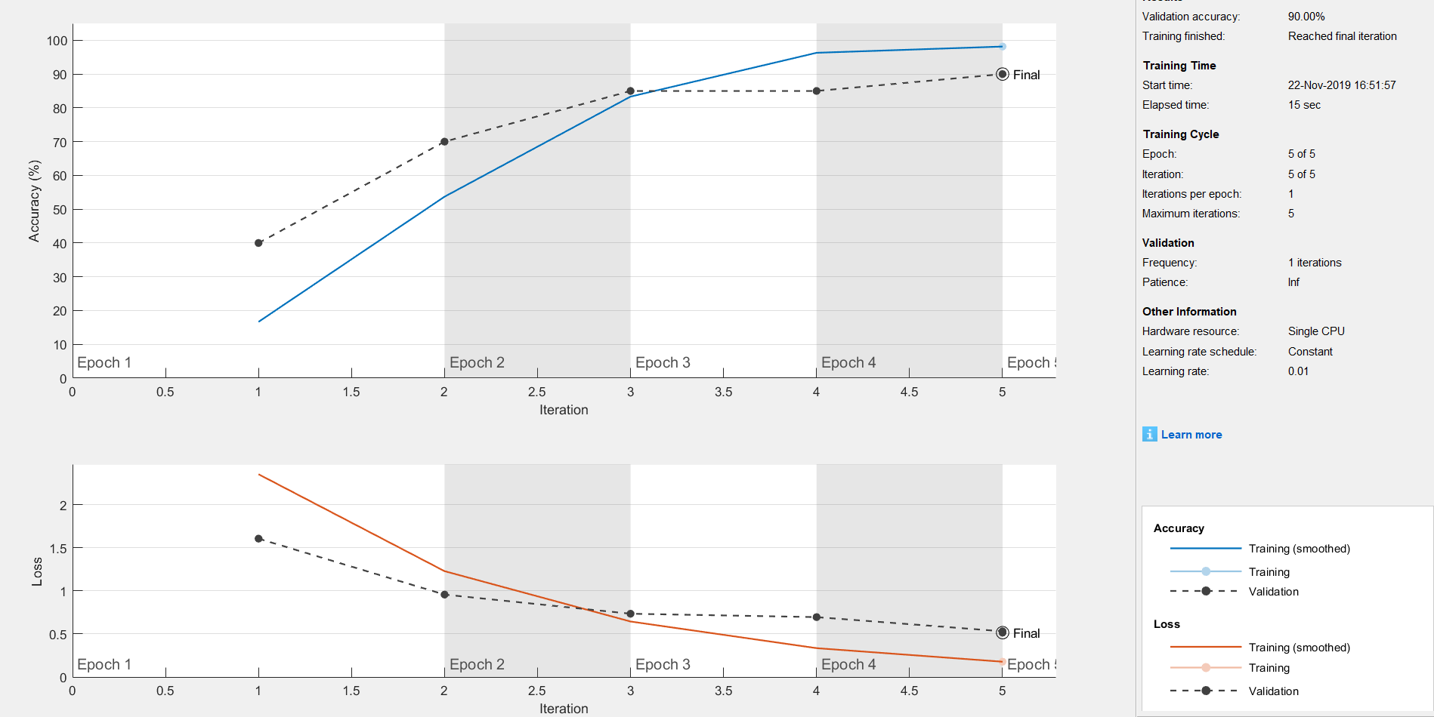

Slide 13
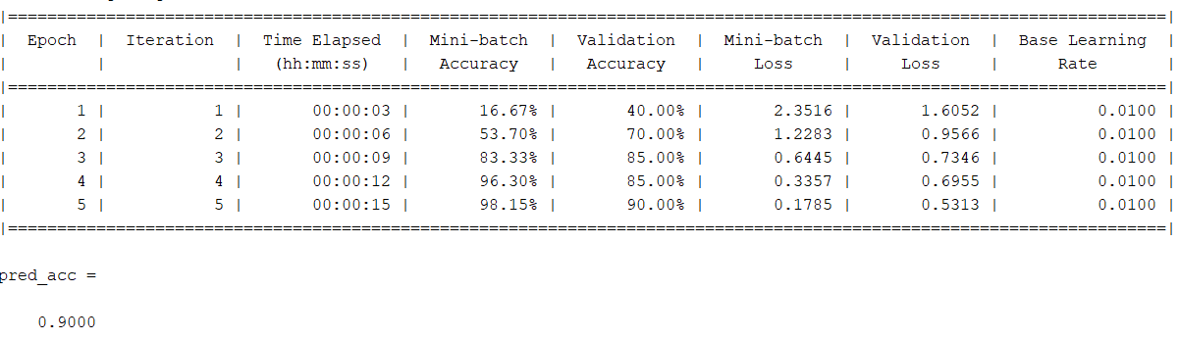



Slide 14
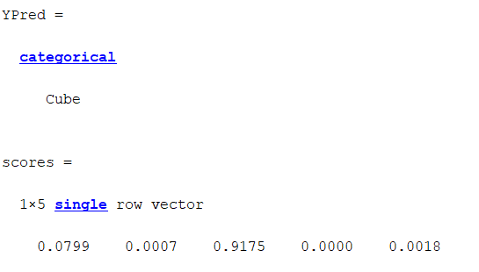
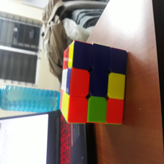
Testing the Network
Input Image

Slide 15
Applications
Real time Identification of Objects
Self Driving cars

Slide 16
Thank YOU

